Slide 1
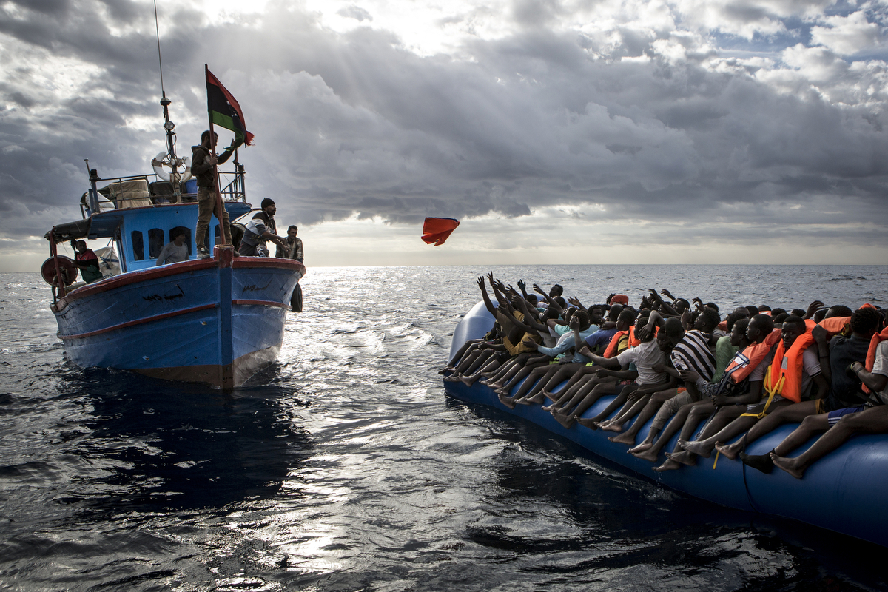
INTERNATIONAL REFUGEES
FROM SHIRKING TO SHARING RESPONSIBILITY

Slide 2
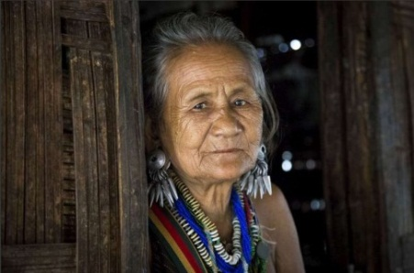
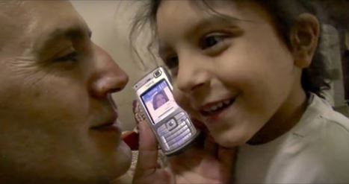
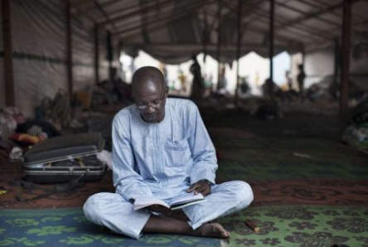
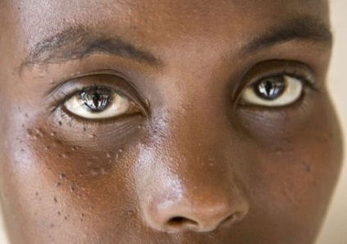
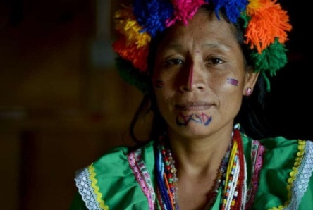
A Refugee is a Person who…. Is out side their country Has a well founded fear of persecution for reasons of ……
Political opinion
Race
Natural
Disaster
WAR
Religion
Is unable or unwilling to return home

Slide 3
Refugee, Migrant, Displaced Person, Asylum Seeker?
Refugee
Forced to flee a country due to persecution
Internally displaced
Forced to flee but does not cross a border to leave their country
Asylum seeker
A refugee who is seeking protection, but no country has ‘determined’ whether or not the person meets the definition of a refugee
Migrant
A person who moves, usually voluntarily, to live or work, either temporarily or permanently. May or may not cross a border.

Slide 4
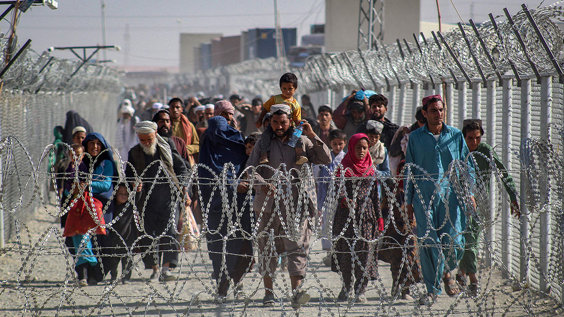
Refugees of Afghanistan
History
Soviet Afghan war
1979 – 1989
Afghan civil war
1992 - 1996
Afghan Taliban war
2001 - 2021
Source: https://www.cfr.org/in-brief/where-will-afghan-refugees-go

Slide 5
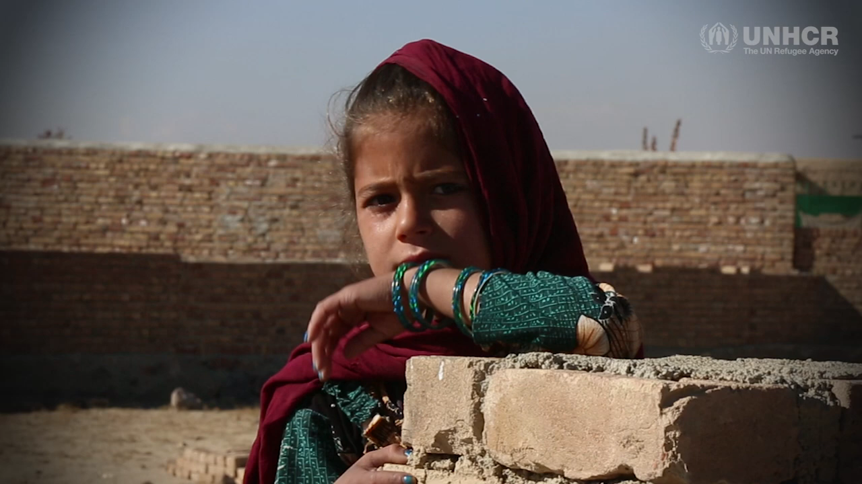
Afghan refugees

Slide 6
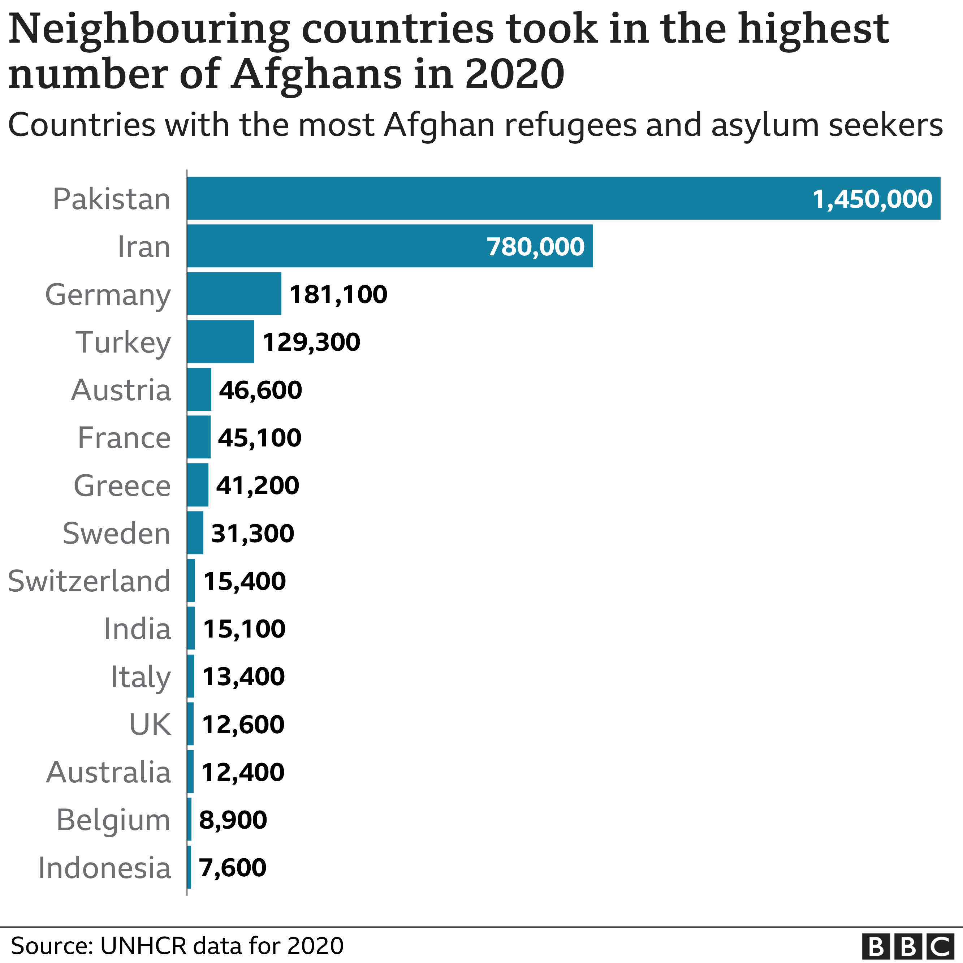

Slide 7
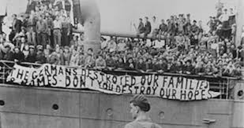
Jewish Refugees
1933 to 1941
Reich’s Jews
More than 340,000
Germany and Austria to European countries
- 100,000 found and killed

Slide 8
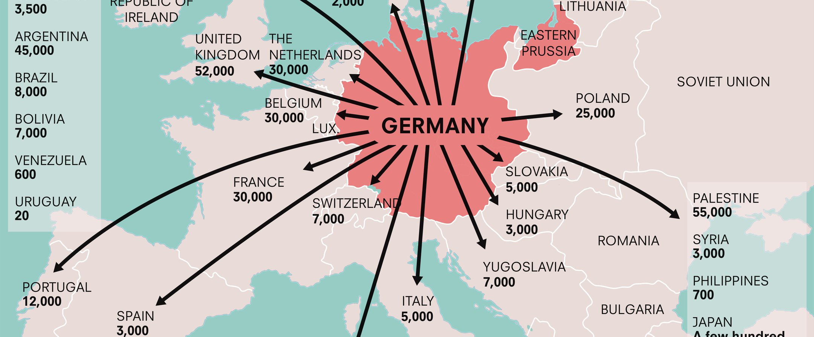

Slide 9
Kurd refugees
Who is Kurds ?
Sultan Salahuddin ayyubi
Kurds still continuesly struggling for freedom
Turkey = 14.7mi Iran = 8.1 mi
Iraq = 5.5mi Syria =1.7mi
western Europe = 1.5 -1.7mi

Slide 10
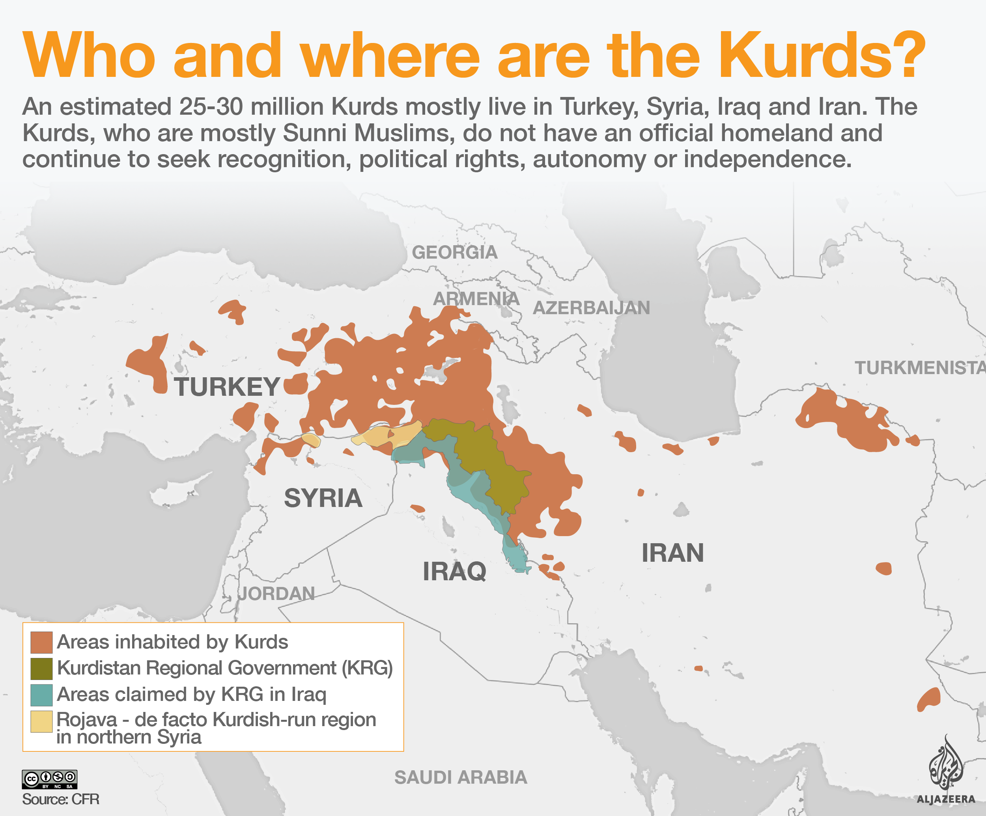

Slide 11
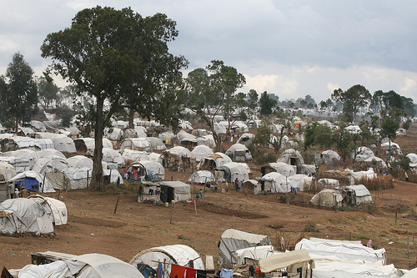
Kurd Refugees
Can Kurds form their own state?

Slide 12
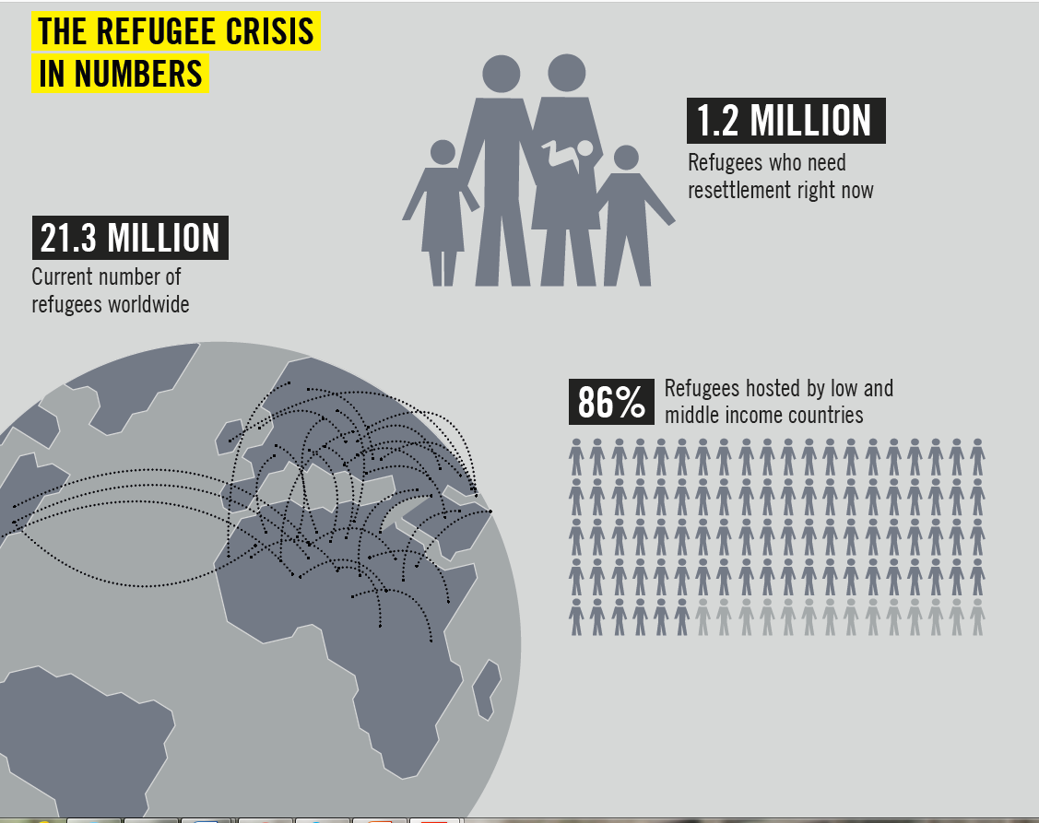

Slide 13
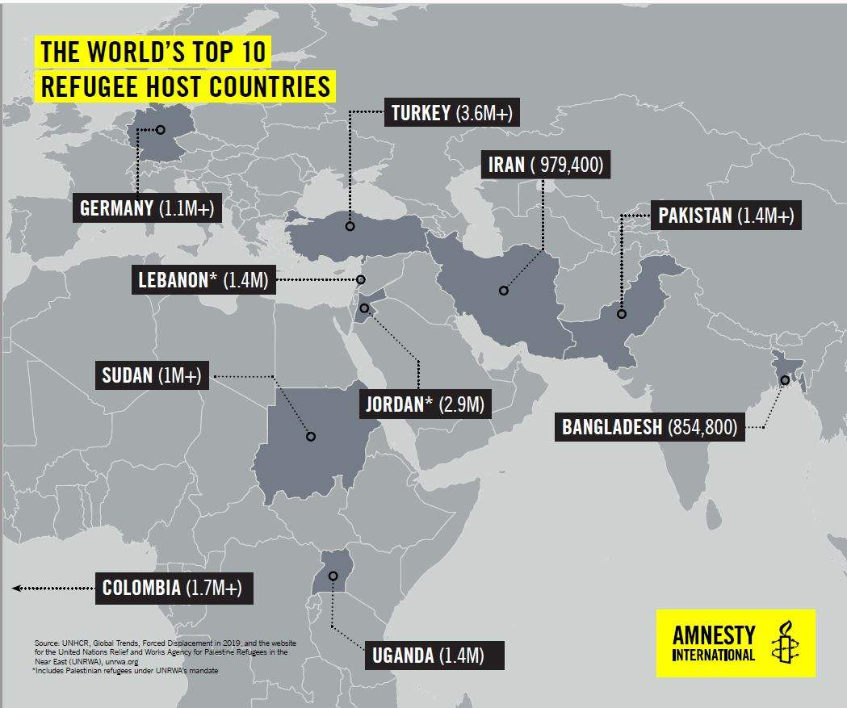

Slide 14
Benefits of Refugees
Tax revenue
Raise productivity
Improve local wages
International trade

Slide 15
Problems caused by refugees
Social issues
Resettlement stress
Security problems
Government spending

Slide 16

I Welcome: Campaign Goal
GOAL
Refugees are protected and enjoy their human rights through strengthened global responsibility-sharing and international cooperation.

Slide 17
What is responsibility-sharing? Protect the Rights of Refugees
Open up more safe and legal routes for refugees
Guaranteed funding of humanitarian appeals
Distribution mechanism for resettlement
(10% of refugees by 2018 or 2.1 million)

Slide 18
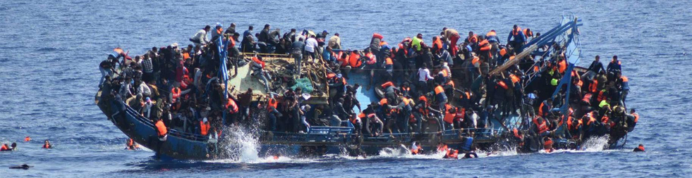
2. Safe and legal routes
Provide refugees with visas to travel safely and apply for asylum when they arrive.
Enhance family reunification; enables people to reunite with relatives who are already in a country.
Develop and improve asylum systems to guarantee access to fair and efficient asylum processes

Slide 19
Mexico and USA: Refugees not recognized
Neither Mexico or US properly screen for possible asylum claims
Both countries deport Central Americans without properly informing them of their rights to seek international protection (asylum).
In 2015, the US granted only approximately 4% all asylum applications lodged by people from Guatemala, Honduras and El Salvador in immigration courts.
Fewer than 1% of Central Americans formally seek asylum in Mexico and the Commission on Refugees granted refugee status to approximately 27% of claimants in 2015; in the first four months of 2016 this rate rose to 37%.

Slide 20
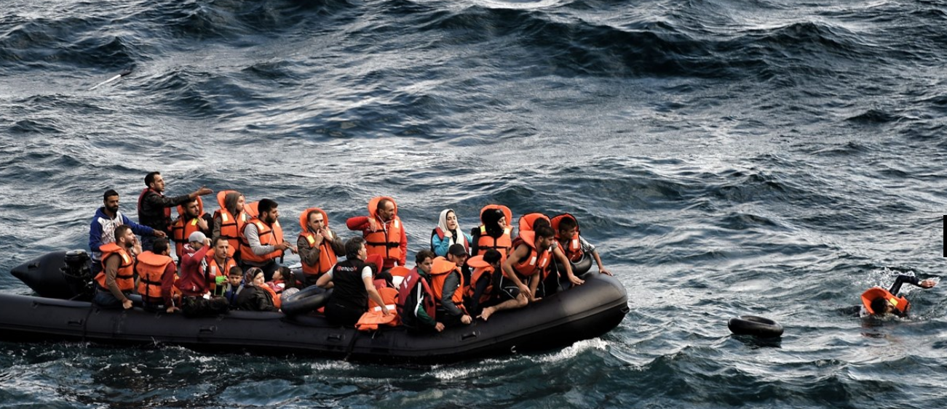
What Can You DO?

